Slide 1
B/B+ Trees
4.7

Slide 2
AVL limitations
Must be in memory
If I don’t have enough memory, I have to start doing disk accesses
The OS takes care of this
Disk is really slow compared to memory

Slide 3

Disk accesses
What is the worst case for the number of disk accesses for:
Insert
Find
Delete

Slide 4
AVL Limitations
AVL produce balanced trees, this helps keep them short and bushy
The more bushy our tree, the better
Reduces the height, so reduces number of accesses
Can we make our trees shorter and bushier?

Slide 5
AVL Limitations
AVL produce balanced trees, this helps keep them short and bushy
The more bushy our tree, the better
Reduces the height, so reduces number of accesses
Can we make our trees shorter and bushier?
Yup, just add more children

Slide 6

M-ary trees
Binary trees have 1 key and 2 kids
M-ary trees have M children
Requires M-1 keys
What is the height?
Notes:
Log base m of n

Slide 7

AVL limitations
If I add more children, then my rotations become very complex.
Just by adding a center child, I double the rotations
CC
CL
CR
RC
LC

Slide 8
More Children
How can I maintain balance with more children?

Slide 9
More Children
Require every node is at least half full
Otherwise degenerates to a binary tree or linked list
How can I maintain balance with more children?
If every leaf is at the same level, is it balanced?
Notes:
Of course

Slide 10
B/B+ Tree
M-ary tree with M>3
Every node at least half full
Except the root
Data is stored in leaves
Internal nodes store M-1 keys, which guide searching
All leaves are at the same depth

Slide 11
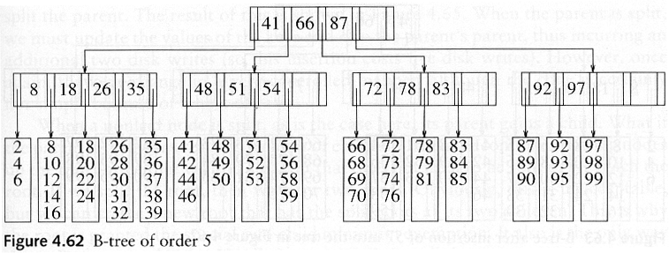
B+ tree
Internal node values
No standard, many ways to do it
We will use the smallest value in the leaf to the right

Slide 12
B+ Tree
Search
Similar to binary trees
If search is smaller than key, go left
If search is larger than the key, look at the next key
If there is not a next key, go right

Slide 13
Searching
Find 41, 99, 66, 52

Slide 14
B+ Tree
Insert
Similar to binary trees on the way down
Find where to insert
When hit a leaf, insert at the leaf
Have to check for overflowing nodes on our way back out
Also have to update parent keys

Slide 15
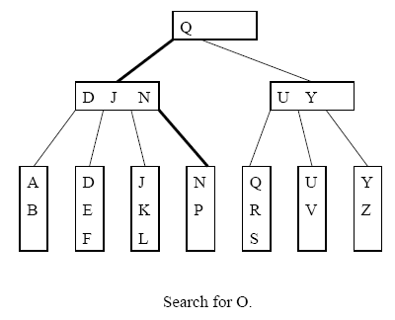
Insert
Insert O

Slide 16
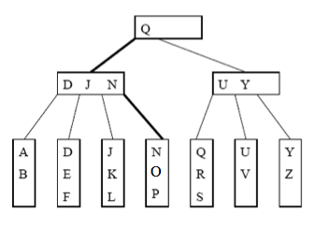
Insert Continued
Insert O
After the insert

Slide 17
Insert
Insert W

Slide 18
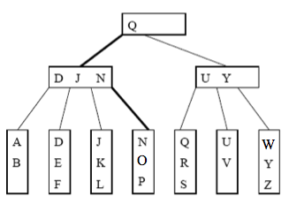
Insert Continued
Insert W
After the insert

Slide 19
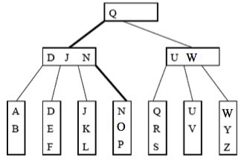
Insert Continued
Insert W
Update the parent key with the smallest value in the right

Slide 20
Insert Continued
Insert X

Slide 21
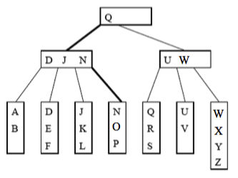
Insert Continued
Insert X
After the insert

Slide 22
Overflowing nodes
We split into two nodes giving half the values to each
Choose a key for them
Smallest in the right
Insert the key into the parent

Slide 23
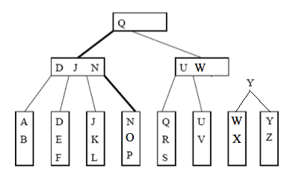
Insert Continued
Insert X
Split the node, choose a key

Slide 24
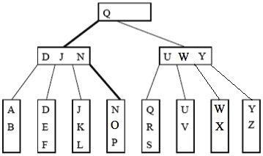
Insert Continued
Insert X
Put the key in the parent

Slide 25
Insert
Insert T

Slide 26
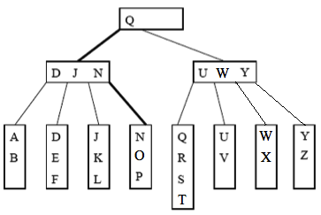
Insert Continued
Insert T
After the insert

Slide 27
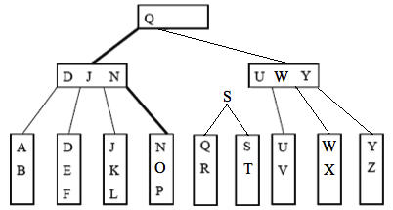
Insert Continued
Insert T
Split the node, choose a key

Slide 28
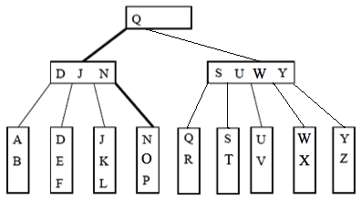
Insert Continued
Insert T
Put the key in the parent

Slide 29
Overflowing internal nodes
We split into two nodes giving have the values to each
Choose a key for them
Smallest in the right
Remove this from the right node
Insert the key into the parent

Slide 30
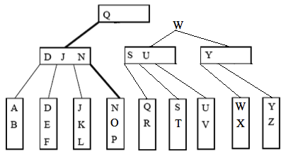
Insert Continued
Insert T
Split the parent, choose a key

Slide 31
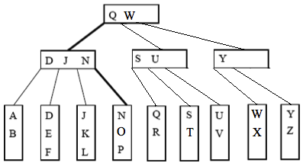
Insert Continued
Insert T
Put the key in the parent

Slide 32
Overfilled nodes
If the root gets overfilled, we split it and add a new node on top as the new root

Slide 33
Delete
Find it and delete it
Update the keys
Now we might have under-filled leaves
We may have to merge them
If the node we merge with is full, we will just have to split them
More practical to steal some values from a sibling
If the right-1 is more than half full, take the smallest value
If the left-1 is more than half full, take the largest one
If neither have enough, merge with the right

Slide 34
Delete Example
Delete N

Slide 35
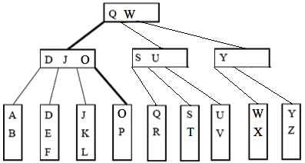
Delete Continued
Delete N
After the delete, key updated

Slide 36
Delete
Delete K

Slide 37
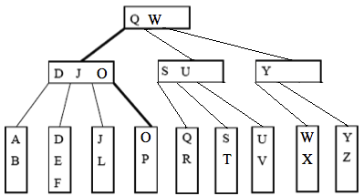
Delete Continued
Delete K
After the delete, no key update needed

Slide 38
Delete
Delete A

Slide 39
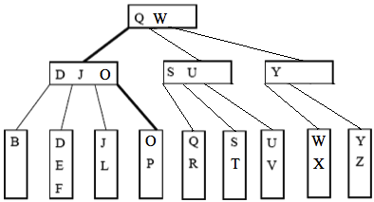
Delete Continued
Delete A
The node is not full enough

Slide 40
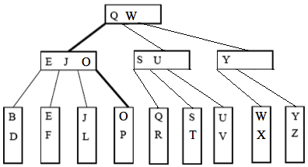
Delete Continued
Delete A
After stealing the D and updating the key

Slide 41
Delete
Delete X

Slide 42
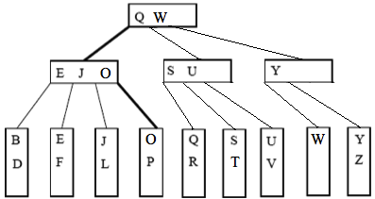
Delete Continued
Delete X
The node is not full enough

Slide 43
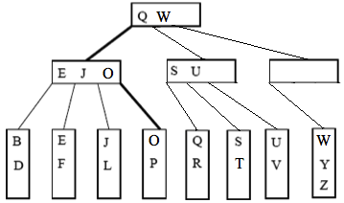
Delete Continued
Delete X
Since there were not enough values to fill two nodes, we merged them
We also updated the key

Slide 44
Under-filled internal nodes
Do the same as a leaf, steal from a sibling or merge
Difference is we drag along the children

Slide 45
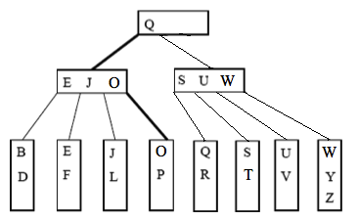
Delete Continued
Delete X
After merging the internal nodes

Slide 46
Delete
Delete U

Slide 47
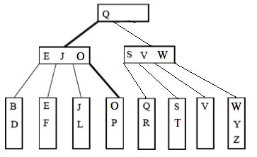
Delete Continued
Delete U
After removing U and updating the parent key

Slide 48
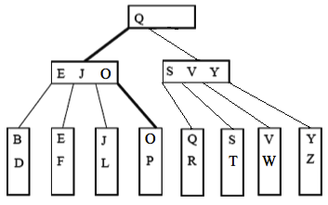
Delete Continued
Delete U
After stealing the W and updating the parent key

Slide 49
Empty Root
If the root ever becomes empty, remove it and make the child the root

Slide 50
Other Trees
Trees are used a lot in Computer Science, there are many more
Expression
Minimum Spanning
Game
Red-Black
Huffman

Slide 51
Red Black-Tree
Popular Alternative to AVL
Operations are O(logn)

Slide 52
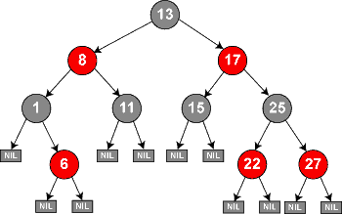
Red-Black Tree
1) Nodes are colored red or black
2) Root is black
3) Red nodes have black children
4) Every path from a node down to a NULL must have the same number of black nodes in it

Slide 53
Red-Black Trees
These rules make our max depth 2* log(n+1)
Means operations are logarithmic
When we insert/delete, we have to update the tree
Must follow the rules
Recoloring
Rotations

Slide 54
Advantages
AVL had to store or re-compute the height
When storing, height is an int, which takes 32 bits
In a red black, we only need to know the color
Since there are only two color options, we only need 1 bit
So, we get the balance advantages of the AVL, and reduce overhead
Makes it really good for embedded systems

Slide 55
Inner workings
Complex and Complicated
We don’t usually talk about them
If you want to use one, you can find implementations
Depending on your libraries, you may already have one

Slide 56
Huffman Tree
Built when doing Huffman coding
Huffman coding is used to compress data

Slide 57
Huffman trees
When we are sending a stream of data, we want to compress it as much as possible
Consider text data
Letter usage is not even
a, e, i, o, u, s, r, t are used much more often than q, z, x, v
We want the letters we use a lot to be fewer bits

Slide 58
Huffman Trees
Find the unique letters in the message
hello world
h
e
l
o
_
w
r
l
d

Slide 59
Huffman Trees
Get the counts of each letter in the message
hello world
h 1
e 1
l 3
o 2
_ 1
w 1
r 1
d 1

Slide 60

Huffman Trees
Combine the two smallest into an internal node
Use their sum as the value
Repeat until you have everything in one tree

Slide 61
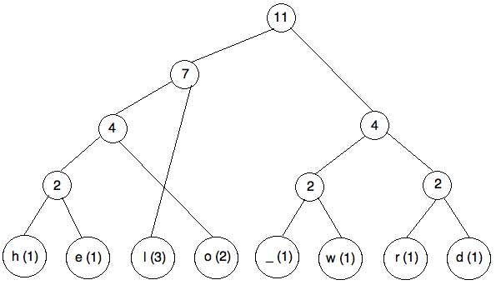
Huffman Trees
Assign left edges as 0’s, right edges are 1’s

Slide 62
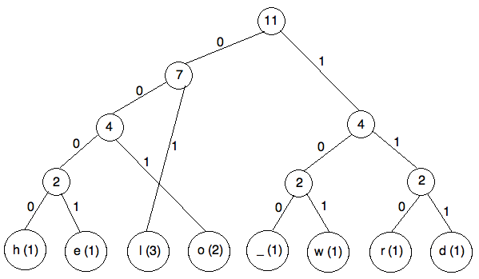
Huffman Trees
Now we follow the tree down and have our codes

Slide 63
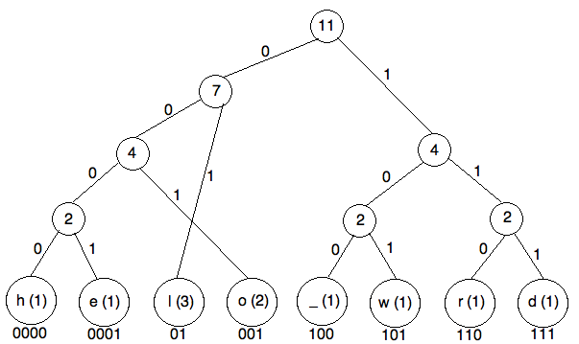
Huffman Trees

Slide 64

Huffman Trees
Now use the codes to translate the message
hello world

Slide 65
Huffman Trees
Now use the codes to translate the message
hello world
0000 0001 01 01 001 100 101 001 110 01 111
(no spaces, just for your visual)
This took 32 bits
To represent 11 items, need 4 bits each, so 44 bits
Char takes 8 bits, so 88 bits

Slide 66
Huffman Tree
Decoding
First pass through the letters and frequencies and build the tree on the other side
Use this to decode

Slide 67
Huffman Trees
0000 0001 01 01 001 100 101 001 110 01 111

Slide 68
Huffman Trees
Gives us a good compression
Transmits the fewest bits possible
Since we have to pass the letters and frequencies in the beginning, we see no advantages for short messages
Don’t get advantages when distribution is even

Slide 69
Huffman Tree
Notice that because values are at the leaves, no code is the beginning of another (or the prefix of another)
This is a good thing, it means translation is not ambiguous

